Slide 1
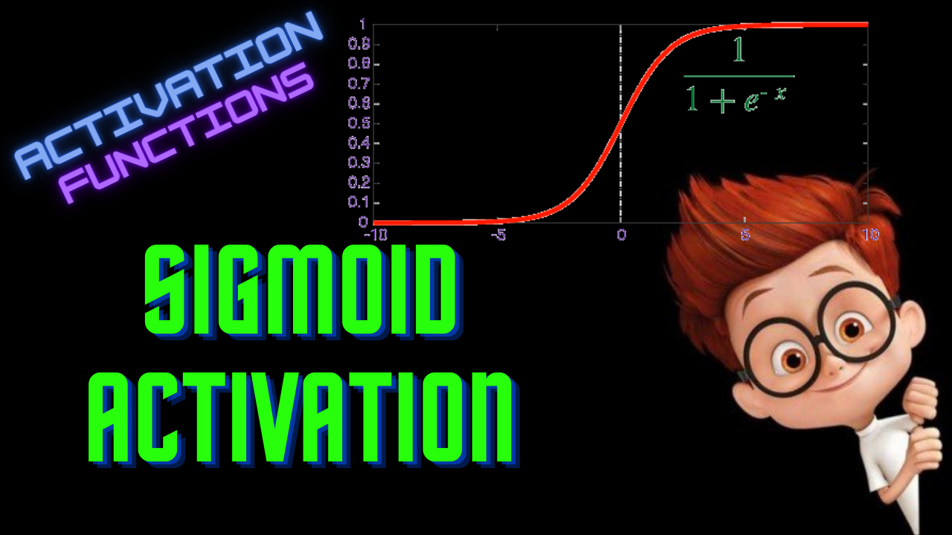

Slide 2
Sigmoid Function
ML For Nerds

Slide 3
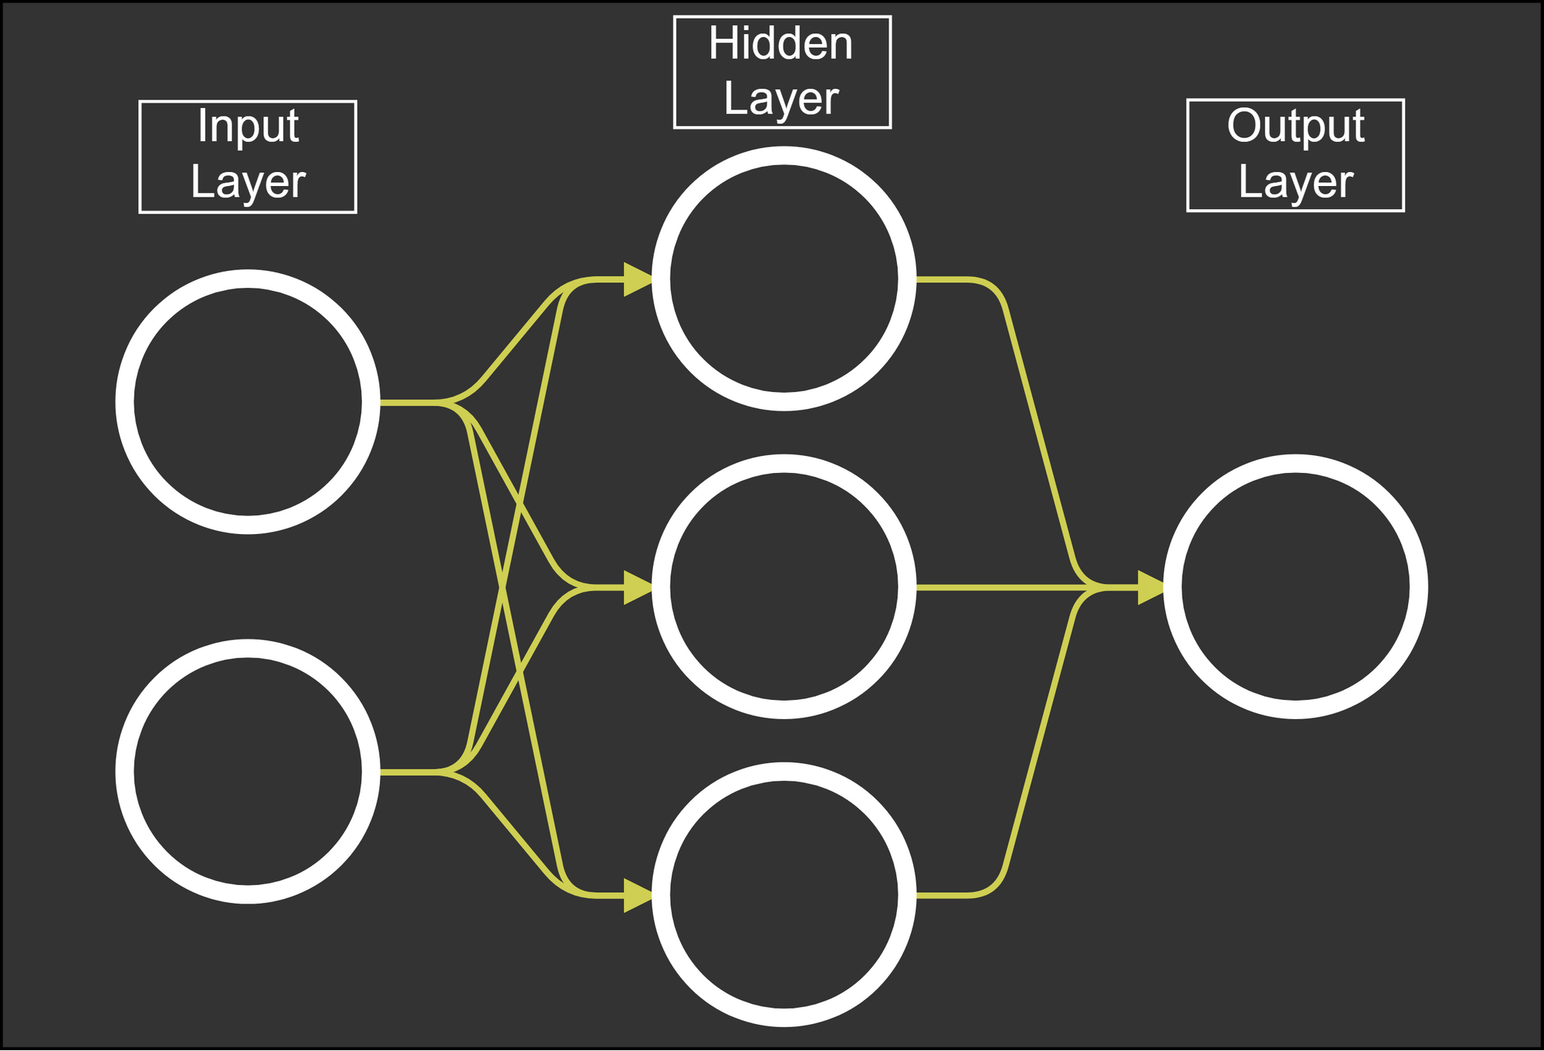


Binary Classification
Inputs: [1,0]
Weights-1: [[1,2],
[2,3],
[3,4]]
Weights-2: [1,2,3]
1
0

Slide 4

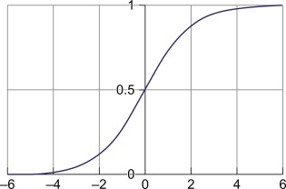
Definition:

Slide 5
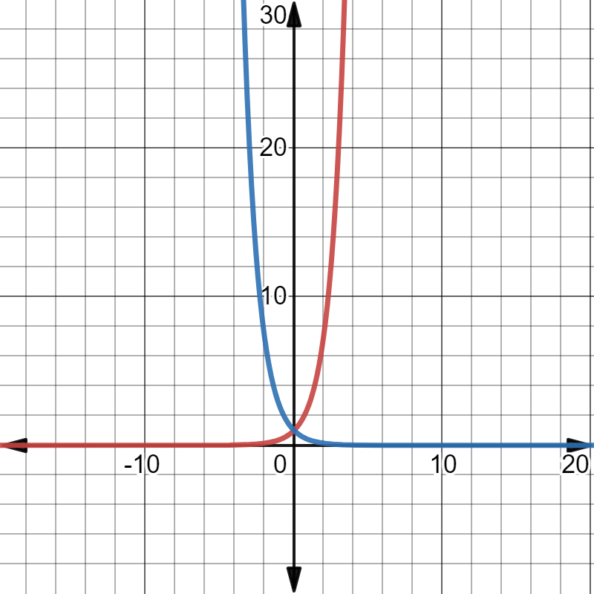
exp(-x)
exp(x)

Slide 7
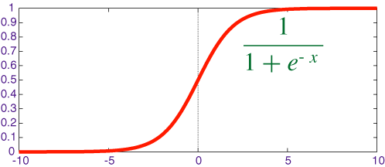

Slide 8
Binary Classification
1
1
2
14
0
3

Slide 9
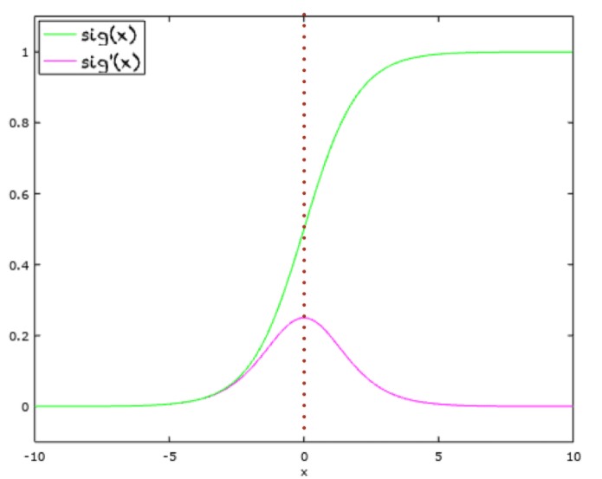
Derivative

Slide 10
Drawbacks
Vanishing Gradient
Not-zero centered

Slide 11
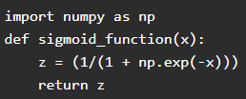

Python code

